Slide 1

Book Reviewing Using Python
Using Flask and PostgreSQL

Slide 2

D.Y. Patil Institute of Engineering and Technology, Pimpri-411018.
Department of Computer Engineering
A Python Project By:
Pragati Parag Bedse - T150244240
Swapnil Sanjay Borase - T150244250
Anjali Arvind Kondle -T150244329
Apurva Ananda Lokare -T150244344

Slide 3
Introduction:
Create a system for BOOK REVIEW in python.
The user should be able to see different reviews & rating of particular book. Reviews are important tools for evaluating books.
Online databases have made book reviews quicker and easier.
Use the profile management system where user will be able to register and create his own profile.
Also he can edit his profile.
The user should be able to give own review and rating for a particular book also.
Based on the reviews and ratings given by user other users can take decision to read that particular book

Slide 4
Objective:
On the basis of above mentioned parameters one can decide to read a particular book.
All details related to different books like reviews, official ratings, comments, etc. can be checked.
User can easily create an account and update the information.
User Friendly Project for easier choice of reading the books.

Slide 5
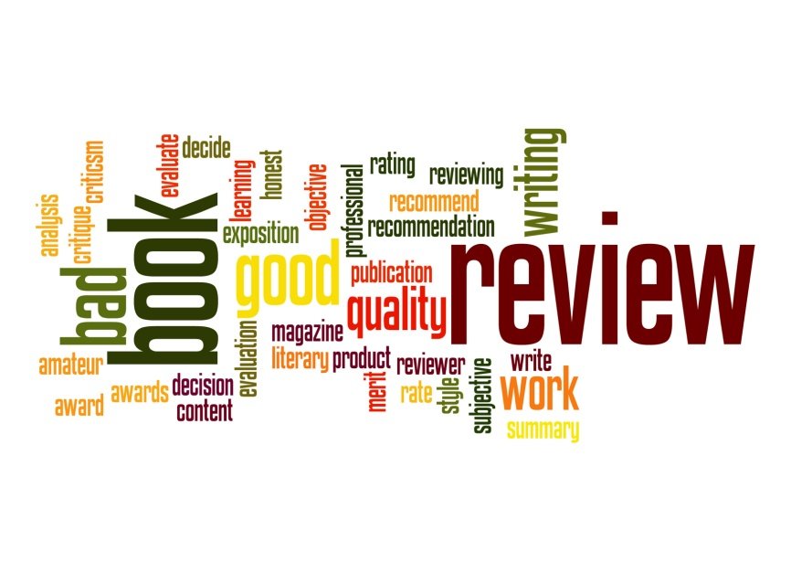
Advantages:
Easy to give rating for a particular book.
Also gives reviews for those particular books.
By seeing the review and rating one can decide to read the book.
Easy to navigate the project.
The star rating of the books give quick review of the book.
This Photo by Unknown Author is licensed under CC BY-NC-ND

Slide 6

Drawback:
There are some standard ratings so we can't change that reviews.

Slide 7
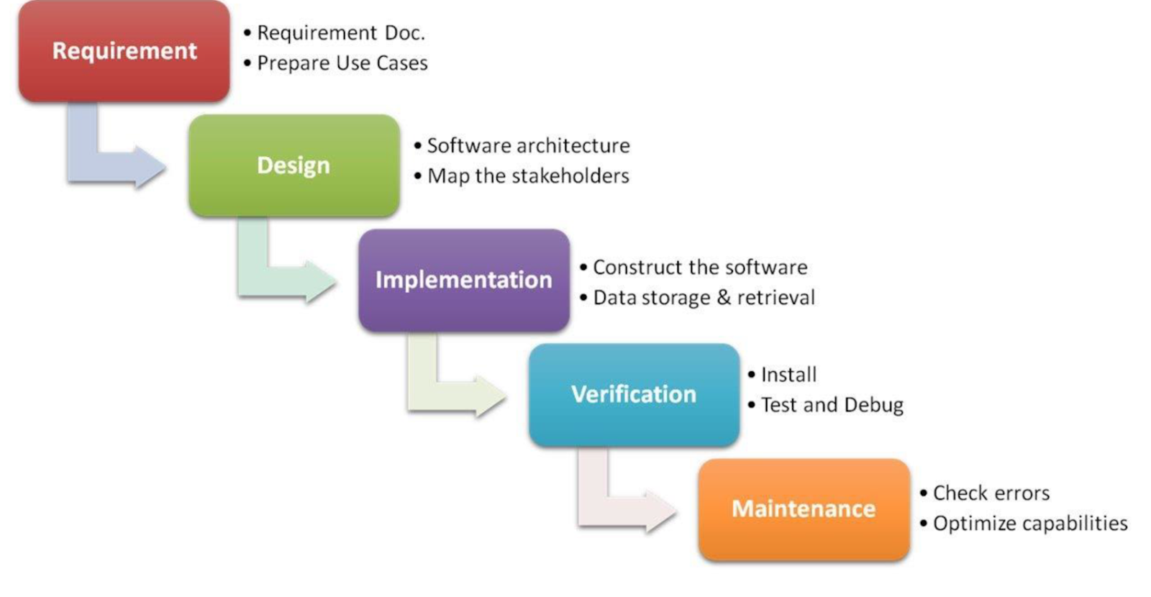
Required Analysis of the Project:

Slide 8
Future Scope of the Project:
Reviews are probably one of the most searched queries on internet.
So a review book is a great idea, especially when it is a book review because books are one of the few products which generally do not have a Return and Money Back policies.
Hence, it is critical for a buyer to get a reliant review before he makes a purchase.
For a good reviewer, writing book reviews well may bring offers of free books from authors, and a reputation as someone who knows about books. It could even lead into other writing-related opportunities
A book summary is an overview of a book’s main points, giving the reader an overall idea of what the book is about.

Slide 9

Conclusion :
The online book review project has been successfully completed.
The goal of system is achieved and problems are solved. Different types of services are provided to both staff and student.
By seeing the standard rating and review he can conclude that the book is helpful or not.

Slide 10
References :
➢ www.youtube.com
➢ www.stackoverflow.com
➢ www.github.com
➢ www.W3Schools.com

Slide 11


